Slide 1
Feature Extraction and Price Prediction for Mobile Phones
BY:- Dharmendra Kumar DATE:- MARCH 2025

Slide 2
PROJECT OVERVIEW
DATA ANALYSIS
VISUALIZATIONS
FEATURE ENGINEERING
MODEL BUILDING
MODEL COMPARISON
MOBILE PRICE PREDICTION MODEL
Agenda

Slide 3
Project Overview
This project, will work with a dataset that contains detailed information about various mobile phones , including their model, color, memory, RAM, battery capacity, rear camera specifications, front camera specifications, presence of AI lens, mobile height, processor, and, most importantly, the price. Your primary goal is to develop a predictive model for mobile phones prices.

Slide 4
Data Analysis
Data Overview
Total Entries: 541
Total Features: 12
Data Types:
Numerical Features: 6
Categorical Features: 5
Target Variable: Mobile SalesPrice
Key Objective: Predict mobile prices based
on Their Model , Colour , RAM, Battery size
, Processor , Camera etc.
Data Exploration
Missing Value /NAN Value Analysis
No columns have missing/nan values.
Unnamed: 0→ Dropped due to the unused
column

Slide 5
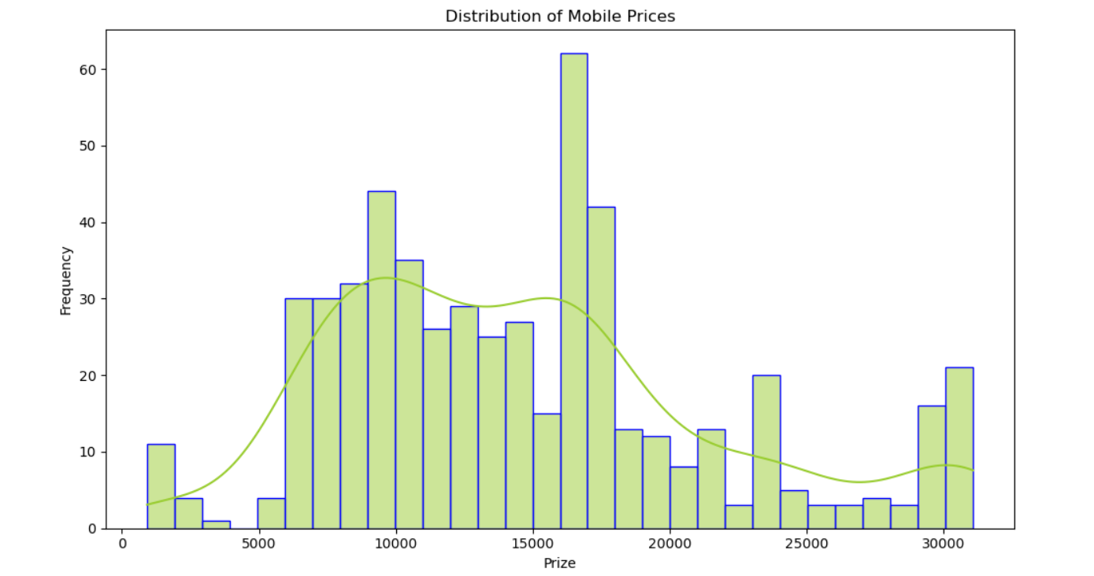
Distribution Of Sales Price
Distribution Shape:
The distribution appears right-skewed (positively skewed).
This suggests that while most Mobile have relatively higher prices.
Peaks & Mode:
The distribution has multiple peaks, indicating that
sale prices are not normally distributed.
The most frequent sale price range appears to be around 15000-16000, where the highest bar is observed.

Slide 6
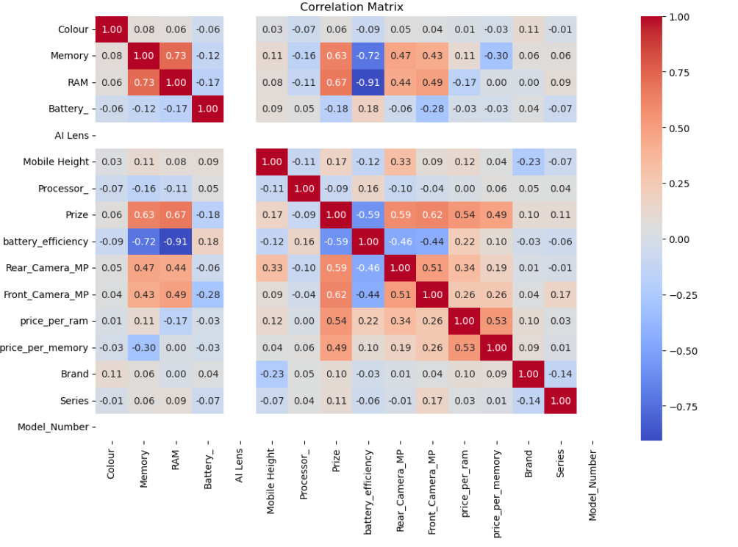
Strong correlations with sale price
Key Insight Of Heat Map
RAM (≈ 0.73): Higher RAM is associated with higher mobile prices.
Memory (≈ 0.63): More storage leads to a higher price.
Processor (≈ 0.50): The processor type has a moderate impact on price.
Rear Camera MP & Front Camera MP (≈ 0.20 - 0.26): Slightly influences price but not as strongly as RAM and storage.
RAM & Memory (≈ 0.73): Higher RAM is often found in phones with higher storage.

Slide 7
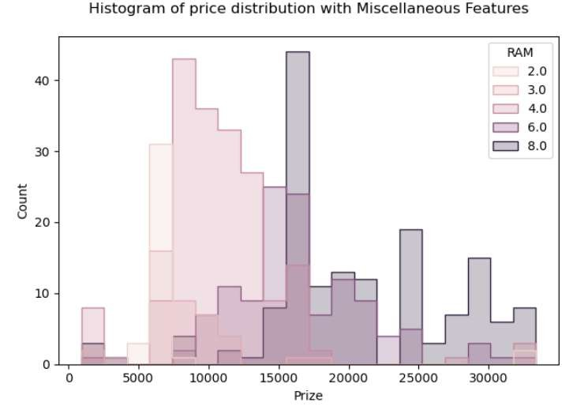
Price distribution with miscellaneous feature
Key Insight Of Graph
The majority of mobile phones are priced between ₹5,000 to
₹20,000, with fewer models beyond ₹25,000.
Lower RAM models (2GB, 3GB, 4GB) are more frequent in the lower price range (₹5,000 - ₹15,000).
Higher RAM models (6GB, 8GB) are more concentrated in the premium price segment (₹15,000 - ₹30,000+).

Slide 8
Price distribution with miscellaneous feature
Key Insight Of Graph
The majority of mobile phones are priced between ₹5,000 to
₹20,000, with fewer models beyond ₹25,000.
Lower RAM models (2GB, 3GB, 4GB) are more frequent in the lower price range (₹5,000 - ₹15,000).
Higher RAM models (6GB, 8GB) are more concentrated in the premium price segment (₹15,000 - ₹30,000+).

Slide 9
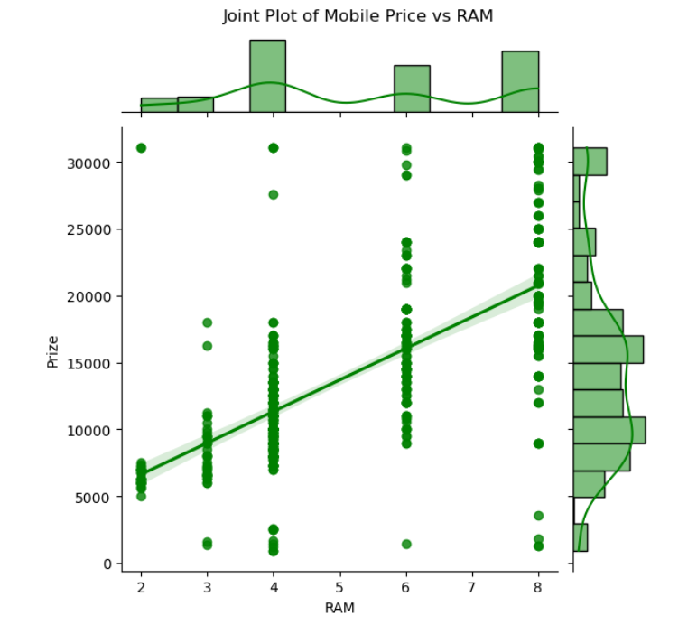
Joint Plot (RAM vs Mobile Price)
Key Insights from the KDE Plot (RAM vs Mobile Price)
Positive Correlation Between RAM and Price
The KDE plot shows that as RAM increases, the mobile price also tends to increase.
This suggests that higher RAM models are generally priced higher.
High-Density Region
The darkest region (highest density) is around 2GB to 4GB RAM and price between 5,000 to 15,000.
This indicates that most mobile phones fall within this range, making it the most common segment in the dataset.
Less Density in Higher RAM & Price
As RAM increases beyond 6GB-8GB, the distribution spreads out, meaning fewer phones have very high RAM and those that do are priced higher.However, the density is lower for very high-end devices, suggesting that flagship models (high RAM & price) are less frequent.
Price Variability at Lower RAM
At lower RAM values (0GB - 2GB), the price distribution spreads widely, meaning there are both budget and slightly expensive models in this category.This suggests that other features (brand, processor, etc.) might also play a role in determining price at lower RAM levels.

Slide 10
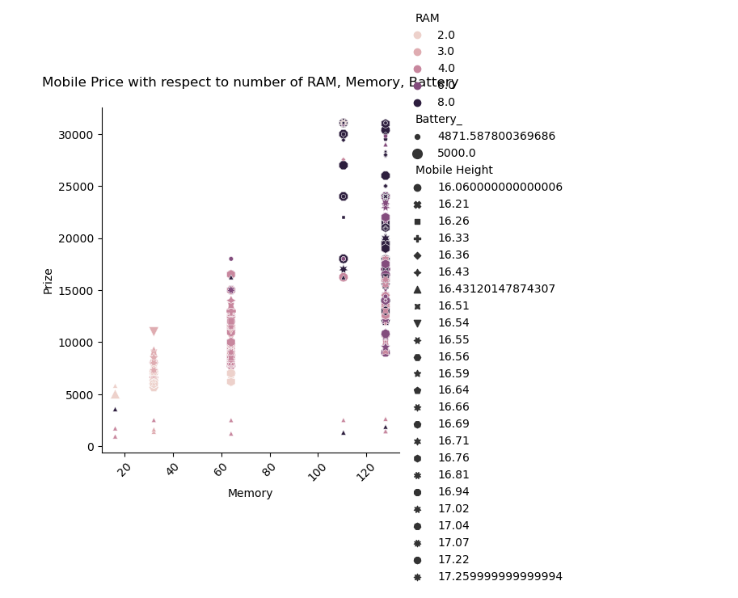
Scatter Plots(Battery , RAM , Memory)
Key Insights from the Violin Plots
Battery Efficiency Distribution (Red)
The distribution appears bimodal (two peaks), indicating two common ranges of battery efficiency.
The middle part is relatively narrow, meaning most values cluster around a certain range.
There are some outliers at the lower end, suggesting a few mobile phones with significantly lower battery efficiency.
RAM Distribution (Yellow)
The plot is multi-modal, meaning there are distinct groups of RAM capacities. The wider sections indicate more common RAM values (e.g., 4GB, 6GB, 8GB). The lower part of the violin is narrow, meaning fewer low-RAM devices in the dataset.
Memory Distribution (Green)
The plot has two distinct peaks, indicating that mobile phones tend to have two common memory capacity ranges (possibly lower-end and higher-end models).
This suggests that most phones either have low or high memory, with fewer in the middle range.

Slide 11
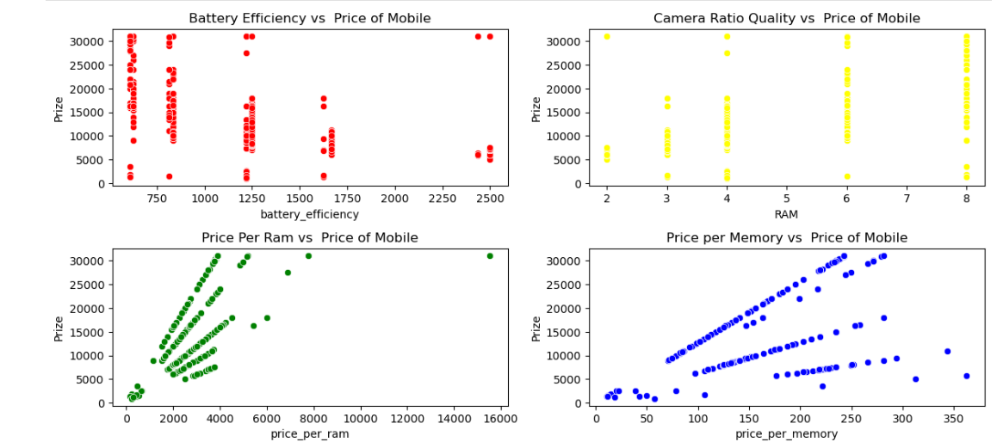
Mobile Price Vs Features
Limited data points for AI Lens.
No clear pattern in pricing based on AI Lens presence.
This feature may not significantly impact mobile pricing.
Higher variance in price for different processors.
Some specific processors are associated with high-
end models.
Premium phones tend to use flagship processors.
Taller phones might be premium models, but not a decisive factor.

Slide 12
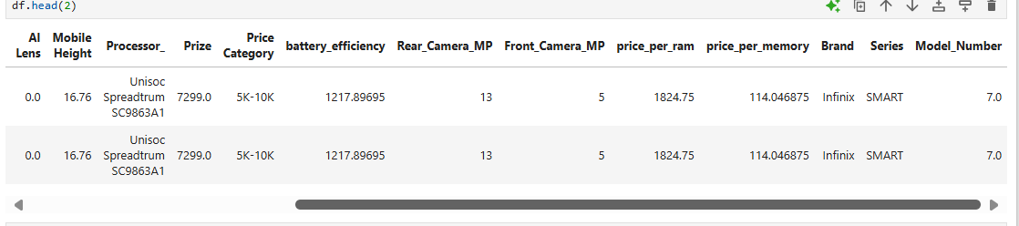
Feature Engineering (New Columns)

Slide 13
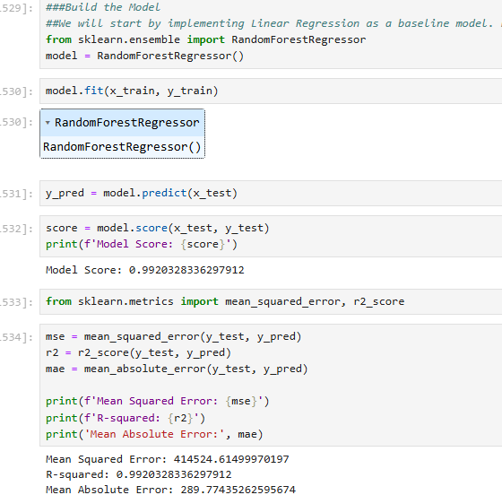
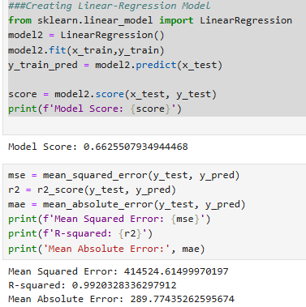
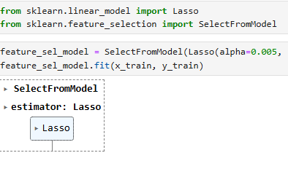
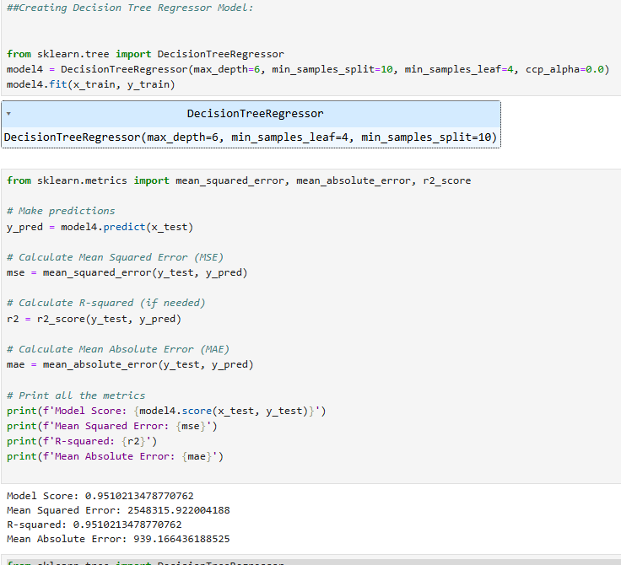
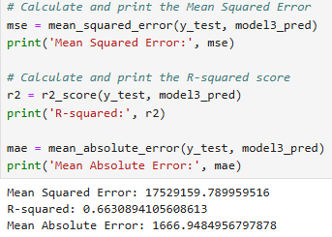
Model Building

Slide 14
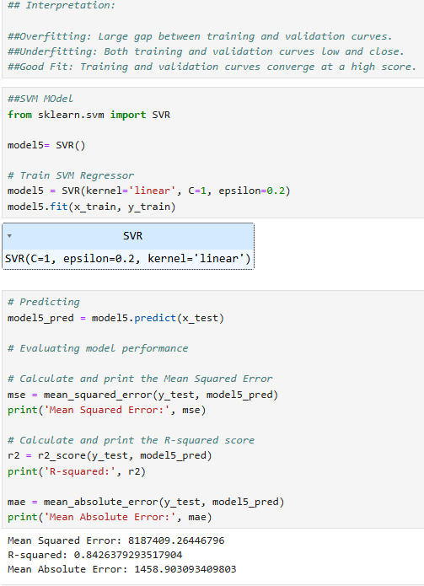
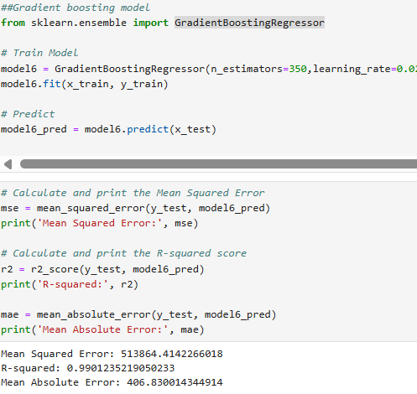
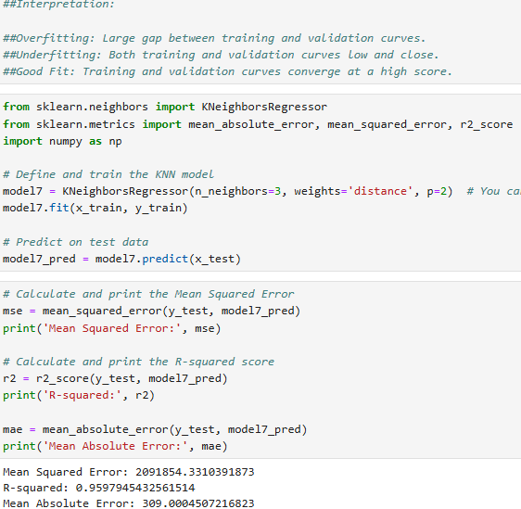
Model Building

Slide 15
Model Comparison
Key Insights
Random Forest - The Top Performer
Mean squared error =414524.61
R-Squared = 0.9920
Mean absolute error = 289.71
Insight:
Random Forest stands out as the best model based on MAE, RMSE, and MSE. It
minimizes errors effectively, showing good generalization and stability.
The low MSE indicates minimal prediction variance, and the low MAE suggests that the model makes predictions that are close to the actual values on average.

Slide 16
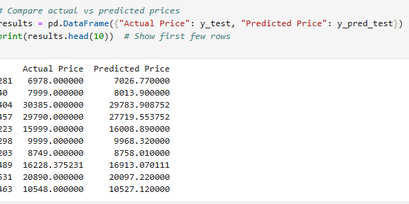
Mobile Price Prediction Model And Comparing Actual vs Predicted Price

Slide 17


